Slide 1
COMPARATIVE RNN PERFORMANCE ACROSS MUSICAL GENRES AND INSTRUMENT CLUSTERS
Agustín Krebs - Alex Rusnak - Axel Sjöberg

Slide 2



What is Genre?
Genre - One of the fundamental cornerstones in categorizing, organizing and describing music
instrumentation, the harmonic content and rhythmic structure are crucial concepts
Automatic genre identification - Difficult but nonetheless popular topic

Slide 3
Previous Research on Genre Identification Generative Models in Music and Horses?
Eck and Schmidhuber in 2002 demonstrated that a RNN can capture the long term structure of a musical style
Zhou et al in 2018 created Bandnet A RNN based MIDI music composition machine that was trained on Beatles song
Strum in 2014 on MIR systems being a “Horse”

Slide 4
Our Research
RNN with LSTM cells
Modified MIDI file data from Million Song Dataset
16 models - 1 for each instrument track (out of 4 in total) over 3 genres

Slide 5
Our Research
Minimize our model’s reliance on characteristics confounded by predefined conceptions of ground truth from musicology.
Use the observations of the model to elucidate some of the characteristics that have been less explored in defining genres and instrument differences.

Slide 6
PREPROCESSING

Slide 7
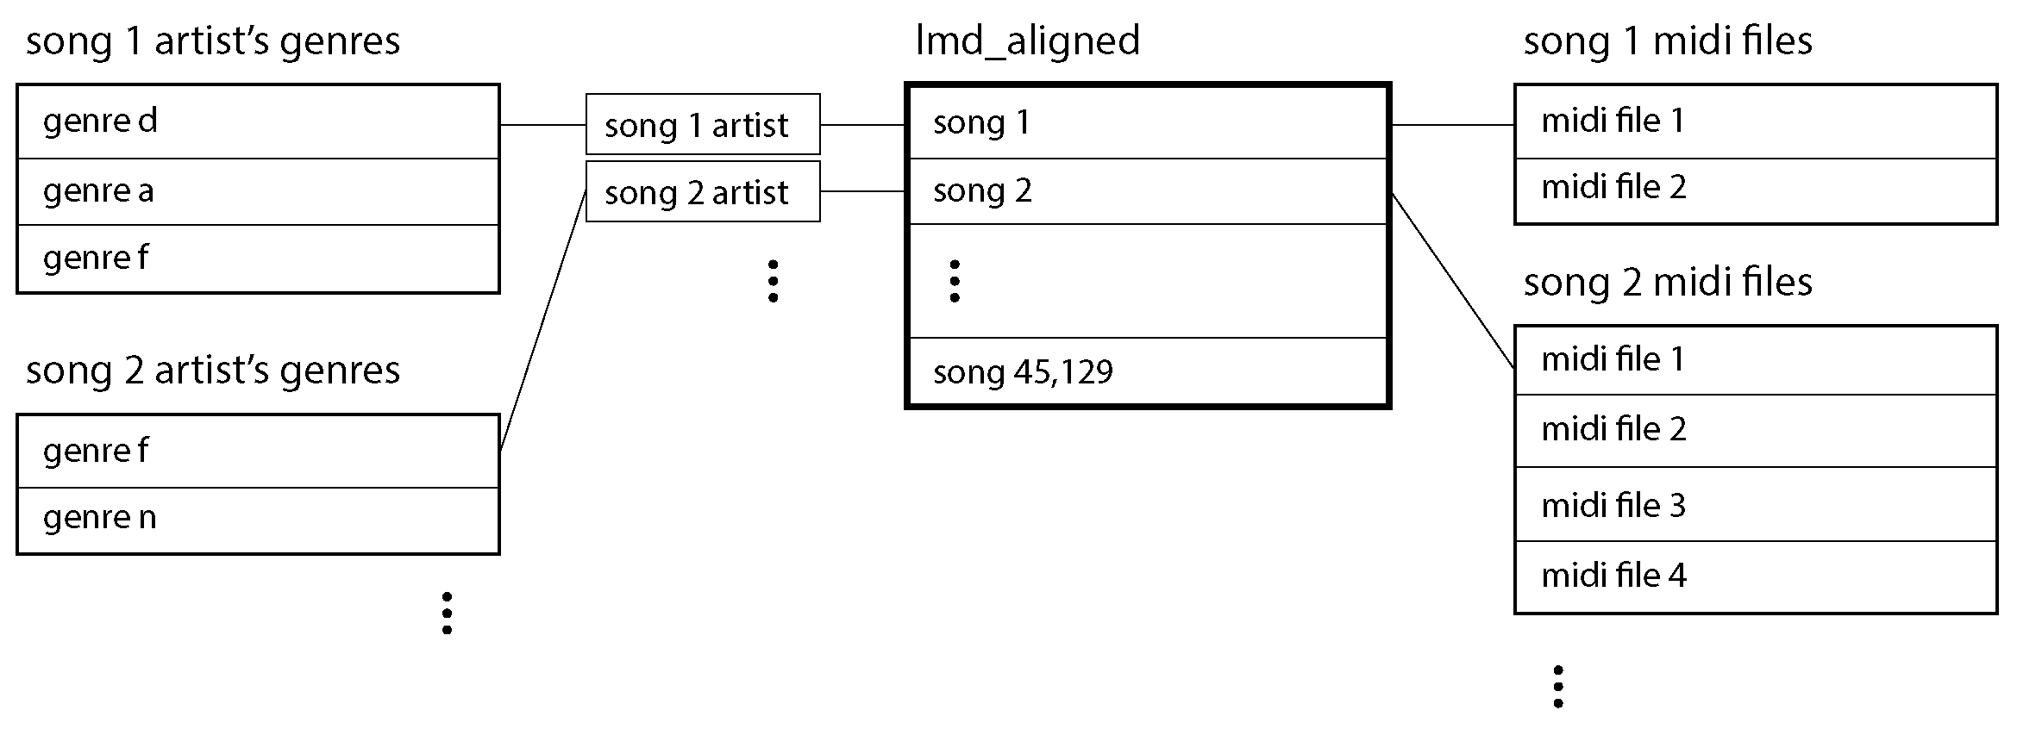
The dataset

Slide 8
The dataset

Slide 9
The dataset

Slide 10
Genre filtering and selection
Track ID: TRESMVD128F9310D57
Genre | Normalized Frequency score
pop rock | 1
rock | 0.93
soft rock | 0.91
glam rock | 0.83
classic rock | 0.76
ballad | 0.50
... | ...
Tags supplied by the echo nest lab
Reduced using a threshold at NF of 0.9

Slide 11
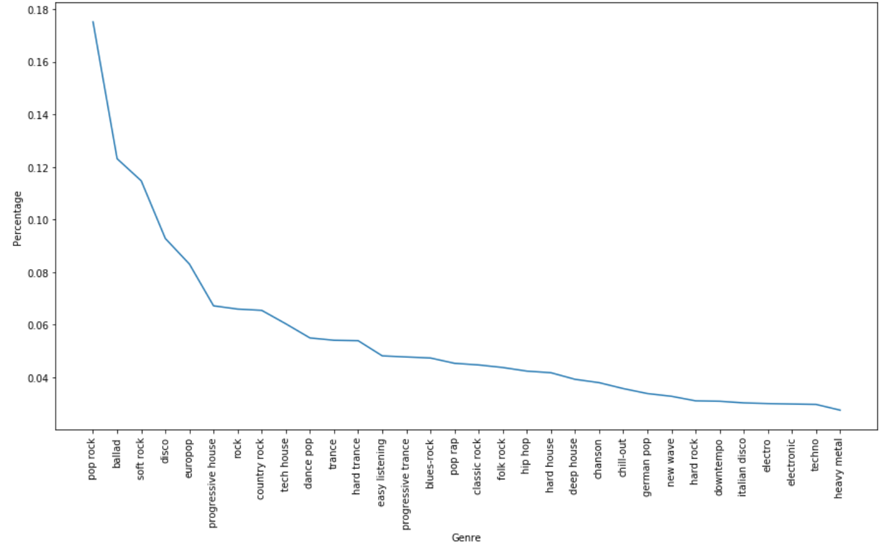
Genre distribution
One song can tag several genres
On average 3.5
Mostly “modern”

Slide 12
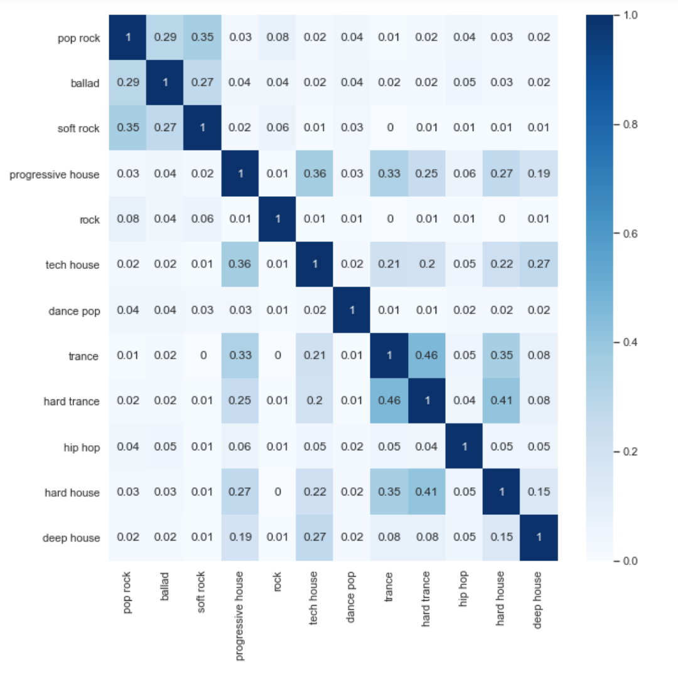
Genre Correlation
Based on Jaccard similarity
Rather expected similarities between genres

Slide 13
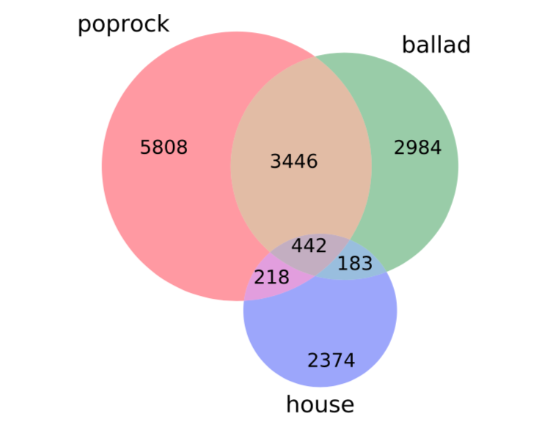
Genre Selection
Pop rock
Ballad
House = Progressive house + hard house + deep house + trance + hard trance.
Jaccard Similarity | pop rock | ballad | house
pop rock | 1 | 0.29 | 0.05
ballad | 0.29 | 1 | 0.06
house | 0.05 | 0.06 | 1

Slide 14
Instrument merging

Slide 15
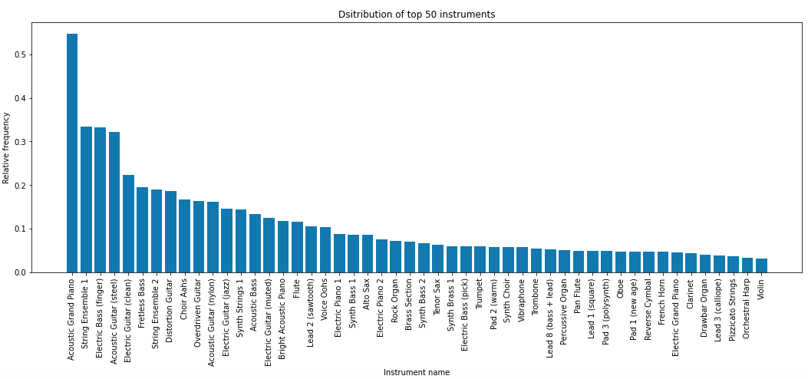
Instrument merging: Distribution

Slide 16
Instrument merging: Distribution
Some instruments are much more present than others

Slide 17
Instrument merging: Distribution
Some instruments are much more present than others
There are too many instruments

Slide 18
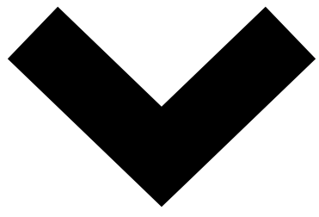
Instrument merging: Distribution
Some instruments are much more present than others
There are too many instruments
Reduce instrument space

Slide 19
Instrument merging: Prior knowledge

Slide 20
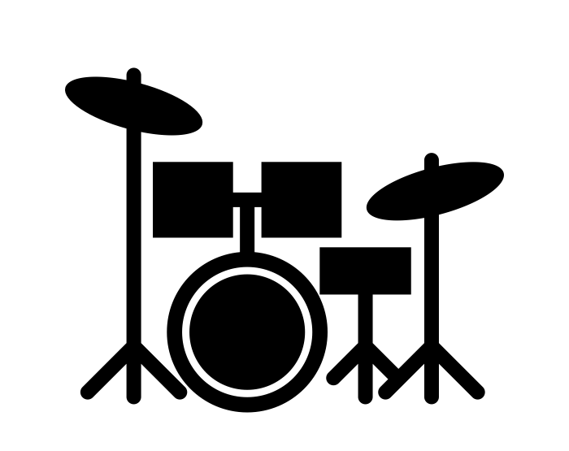
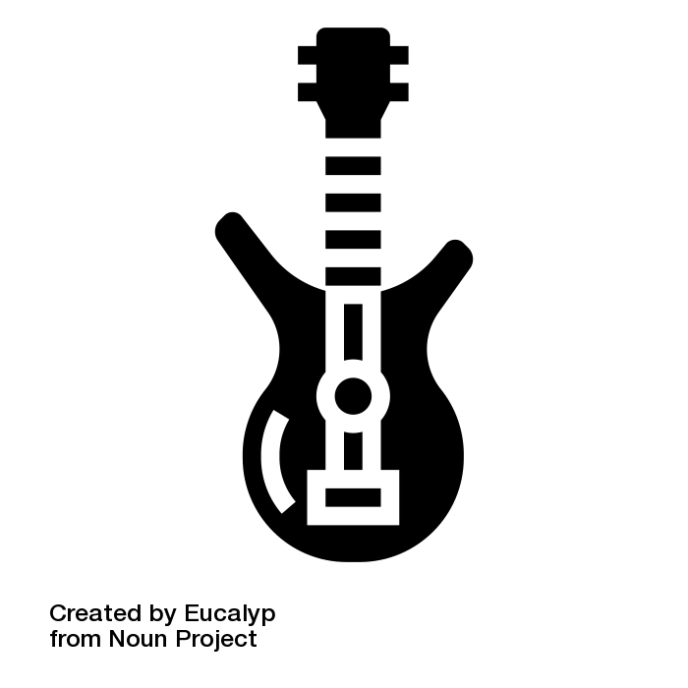
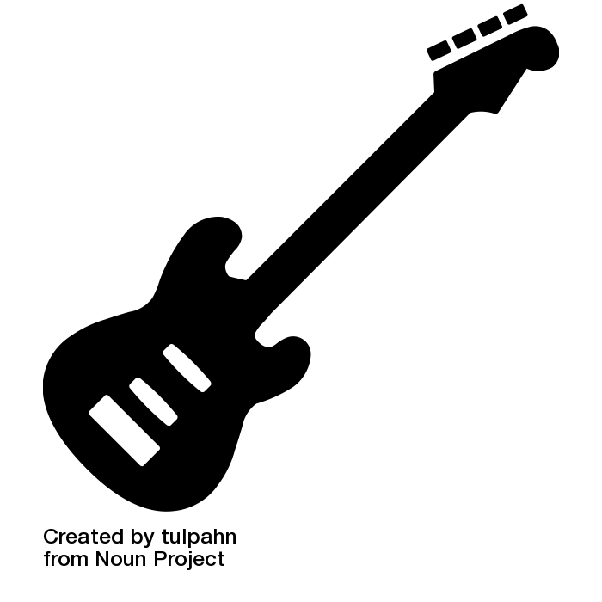
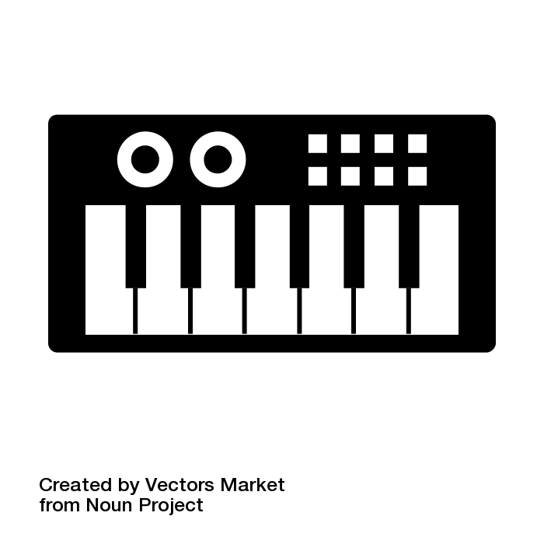
Instrument merging: Prior knowledge

Slide 21
Instrument merging: Clustering

Slide 22
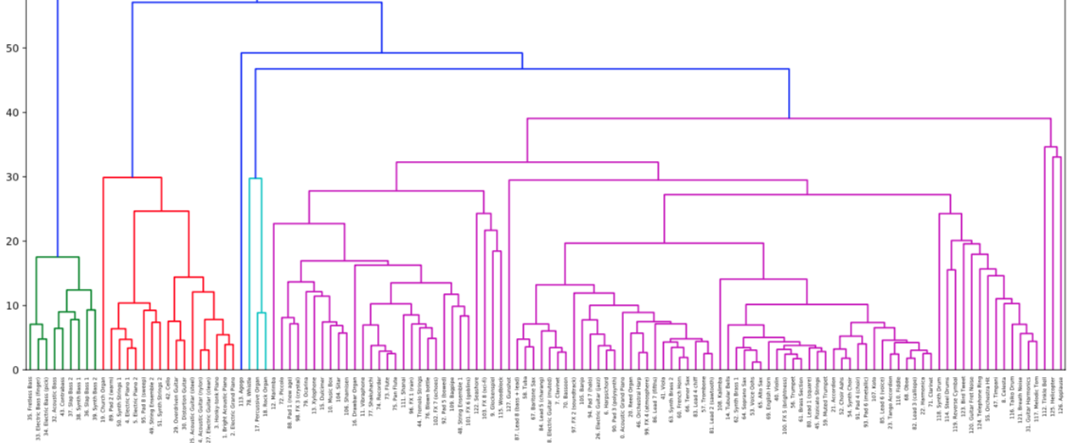
Instrument merging: Clustering

Slide 23
Instrument merging: Clustering

Slide 24
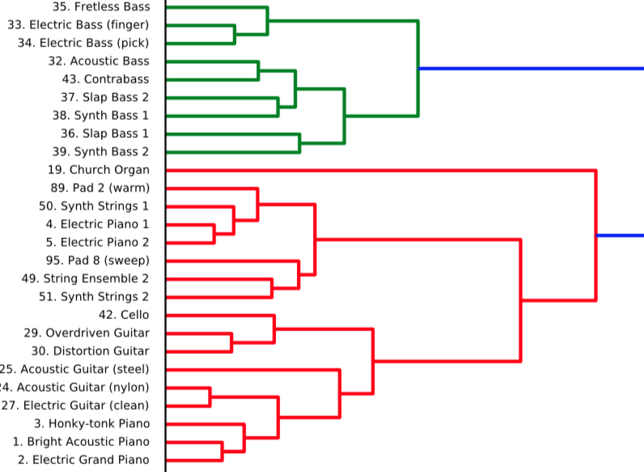
Instrument merging: Clustering

Slide 25
Instrument merging: Clustering

Slide 26

Instrument merging: Clustering

Slide 27
Instrument merging: Clustering

Slide 28

Instrument merging: Clustering

Slide 29
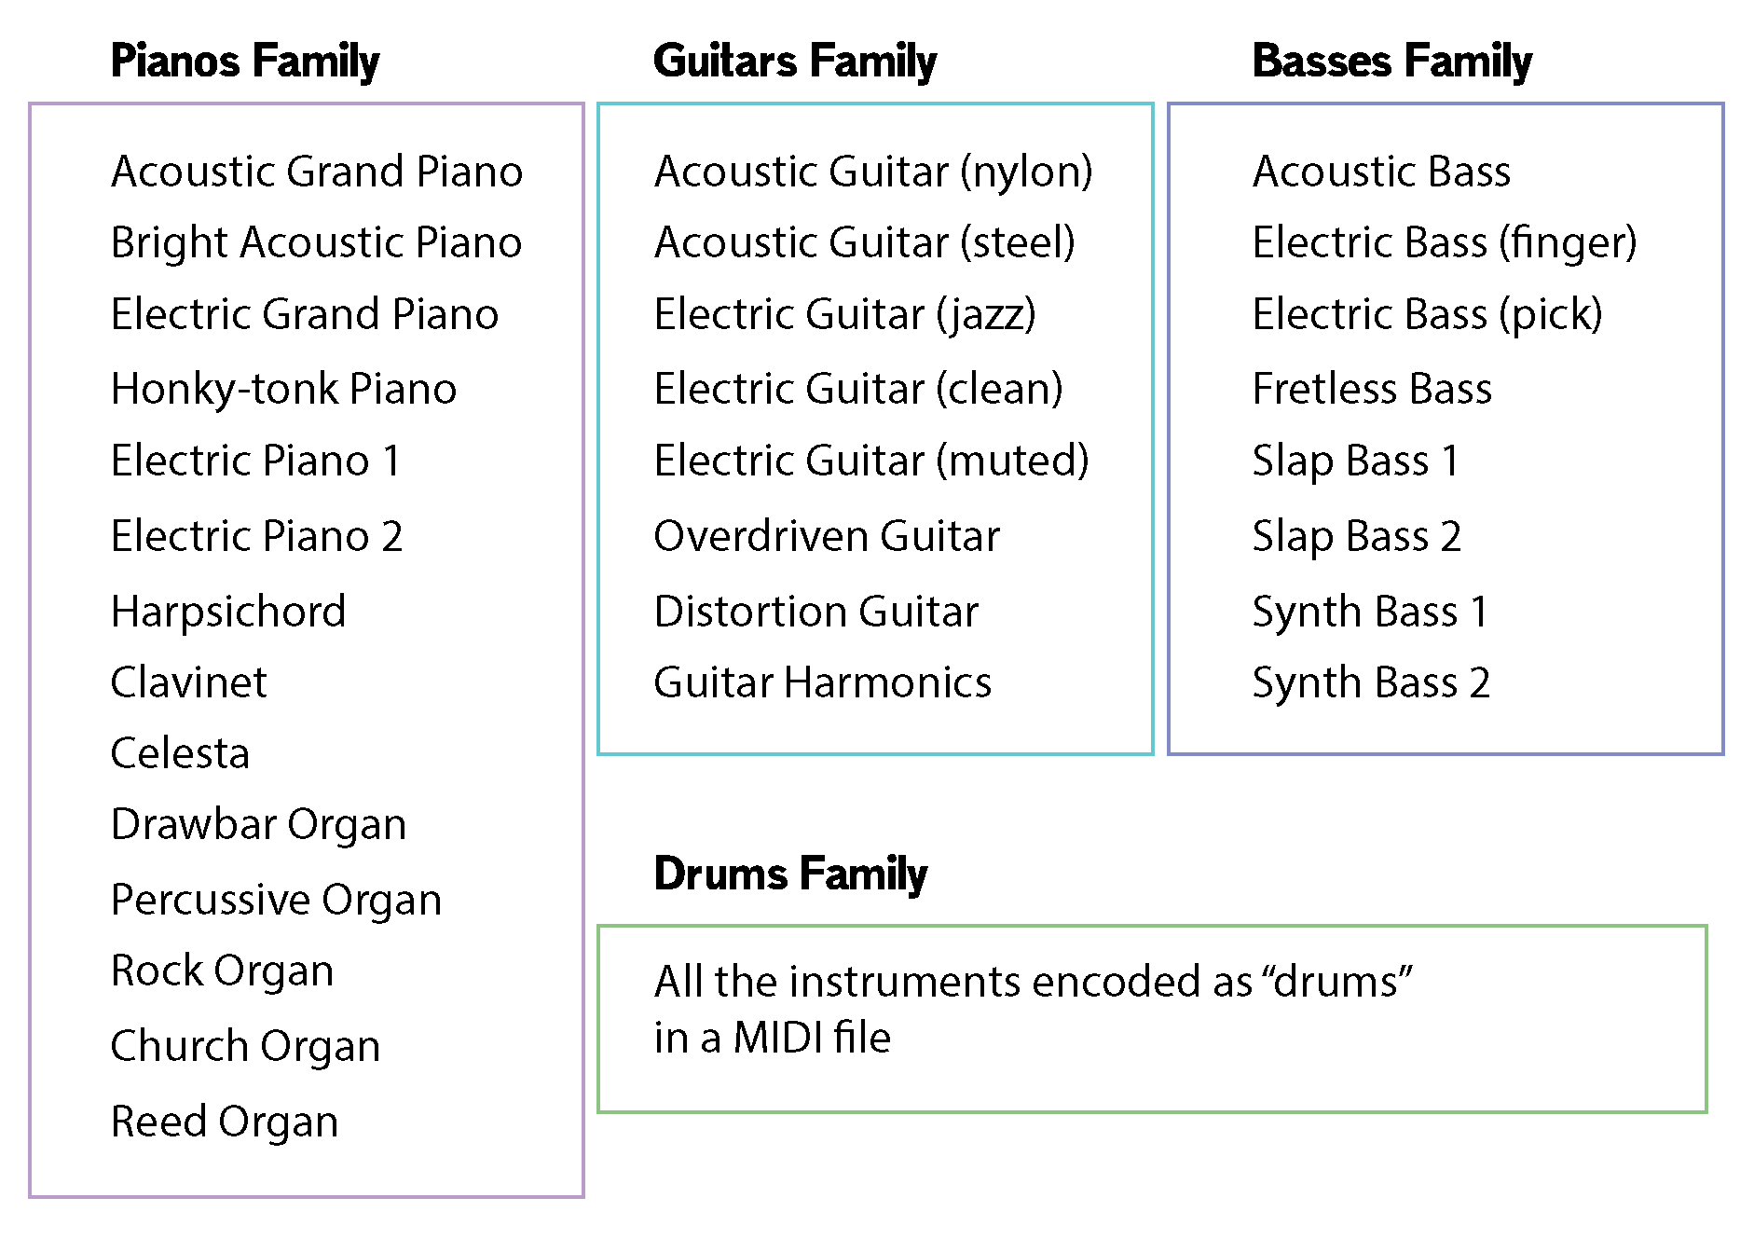
Instrument merging: Final mapping

Slide 30
Songs encoding

Slide 31
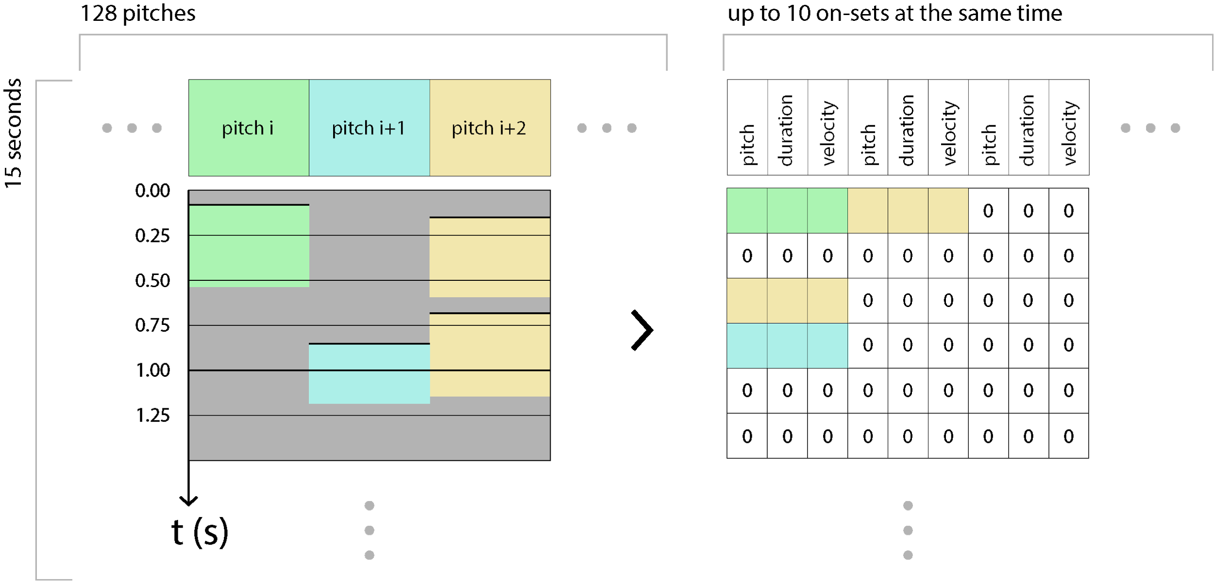
Songs encoding

Slide 32
Songs encoding

Slide 33
Songs encoding

Slide 34
Songs encoding

Slide 35
THE MODEL

Slide 36
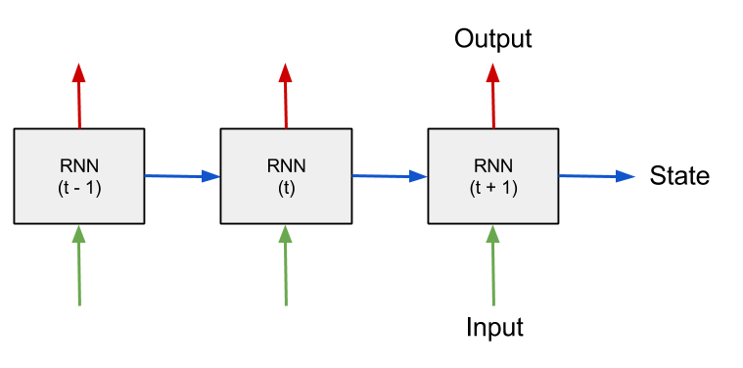
RNNs

Slide 37
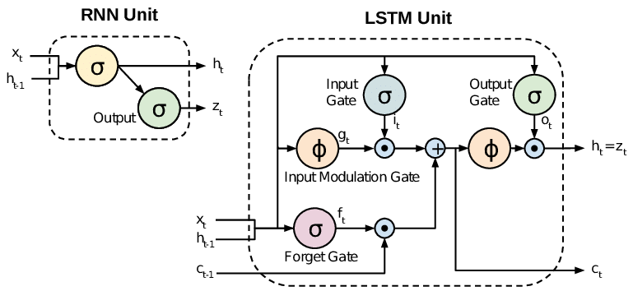
LSTM Cell

Slide 38
Architecture
Input (See encoding)
30x60x4
Output (Logits)
30x60x200x4
Loss
30x60x200
Embedding Layer
200x60x512
Recurrent Layer
2048 Units
Dense Layer
200x60

Slide 39
RESULTS

Slide 40
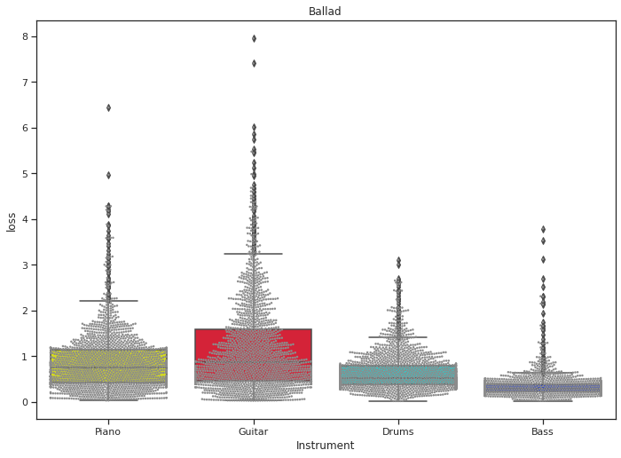
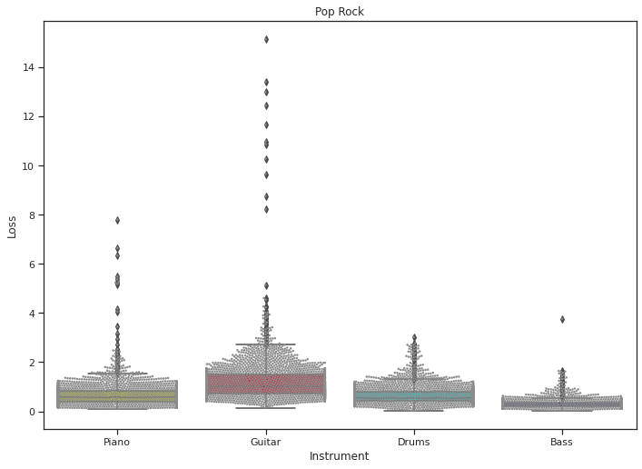
Test Loss by Genre and Instrument

Slide 41
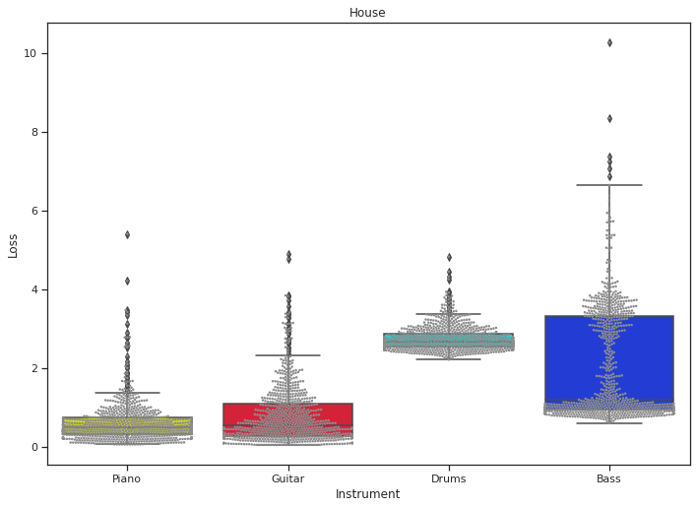
Test loss by genre and instrument (cont.)

Slide 42
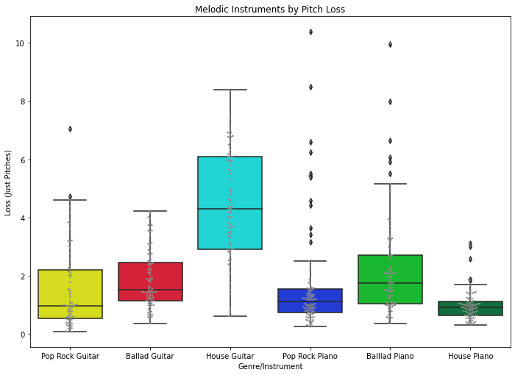
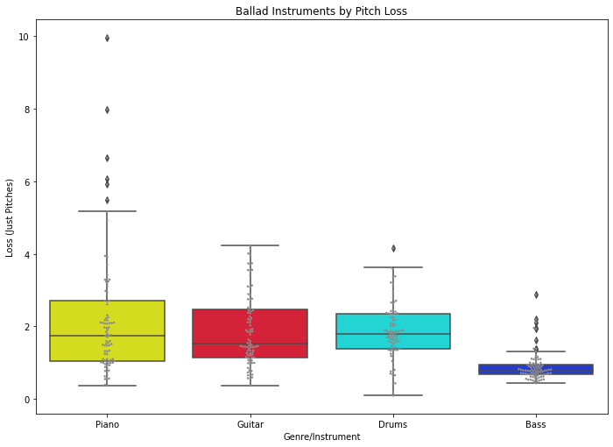
Pitch loss

Slide 43
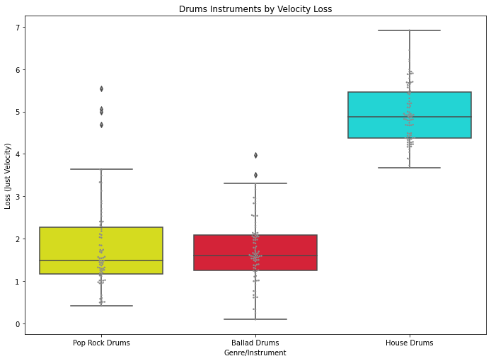
Velocity Loss

Slide 44
Discussion and future work
Encoding style
Larger model
More data
Benchmark (all genres)
Specific Data Clusters

Slide 45
Conclusion
Analysis of suitable genres
Clustering by instrument families
Different model fitting by genre and instrument
Thank You!

Slide 46
Questions

